Slide 1
DEPARTMENT OF MATHEMATICS
SGGSJ GOVERENMENT COLLEGE
PAONTA SAHIB

Slide 2
COURSE NAME : DIFFERENTIAL EQUATION
COURSE CODE : 102TH

Slide 3
CONTENTS
Rules to find integrating factor.
Problem based on integrating factor.

Slide 4
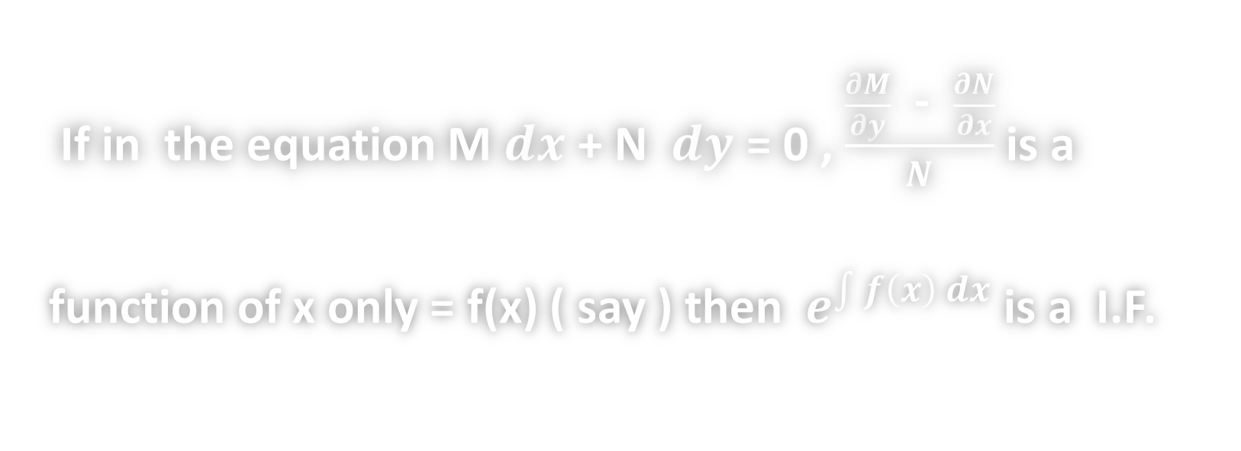
RULE 3
If in the equation M $ⅆx$ + N $ⅆy$ = 0 , $\frac{\frac{∂M}{∂y} \text{− } \frac{∂N}{∂x}}{N}$ is a
function of x only = f(x) ( say ) then $e^{\int{f\left(x\right) dx}}$ is a I.F.

Slide 5
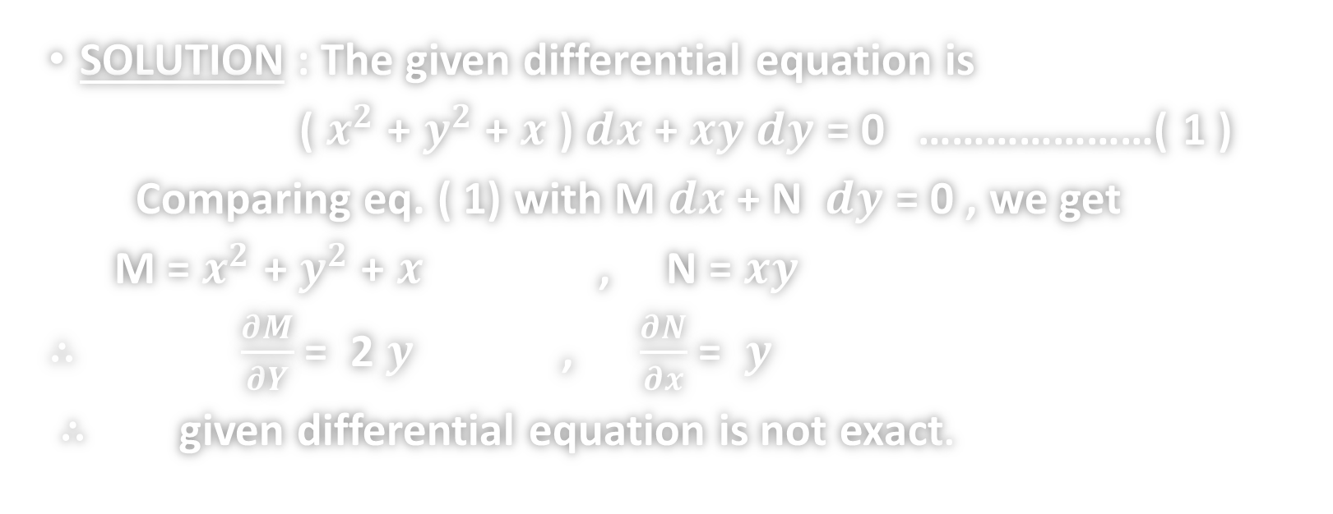

PROBLEM 1 : Solve
( $x^{2}$ + $y^{2}$ + $x$ ) $ⅆx$ + $xy$ $ⅆy$ = 0
SOLUTION : The given differential equation is
( $x^{2}$ + $y^{2}$ + $x$ ) $ⅆx$ + $xy$ $ⅆy$ = 0 …………………( 1 )
Comparing eq. ( 1) with M $ⅆx$ + N $ⅆy$ = 0 , we get
M = $x^{2}$ + $y^{2}$ + $x$ , N = $xy$
∴ $\frac{∂M}{∂Y}$ = 2 $y$, $\frac{∂N}{∂x}$ = $y$
∴ given differential equation is not exact.

Slide 6
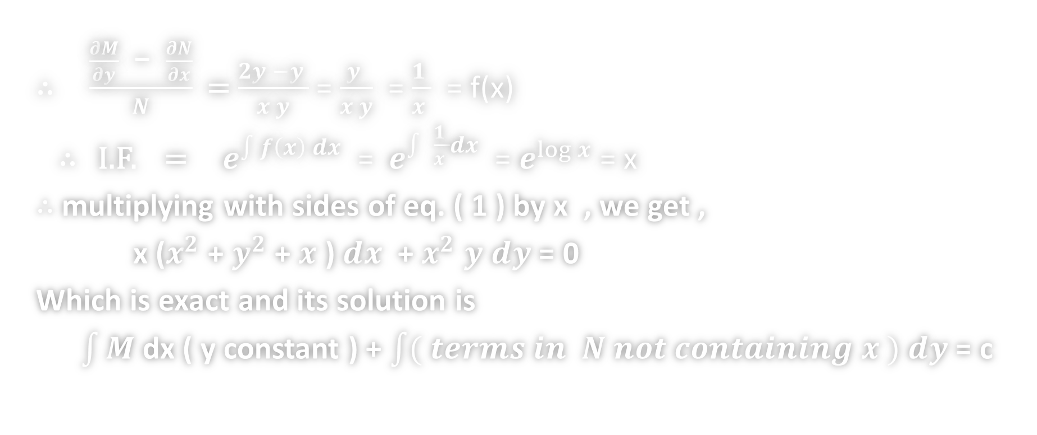
SOLUTION CONTINUES …
∴ $\frac{\frac{∂M}{∂y} \text{− } \frac{∂N}{∂x}}{N}$ = $\frac{2y −y }{x y}$ = $\frac{y }{x y}$ = $\frac{1 }{x }$ = f(x)
∴ I.F. = $e^{\int{f\left(x\right) dx}}$ = $e^{\int{ \frac{1 }{x }dx}}$ = $e^{\log{x}}$ = x
$∴$ multiplying with sides of eq. ( 1 ) by x , we get ,
x ($x^{2}$ + $y^{2}$ + $x$ ) $ⅆx$ + $x^{2}$ $y$ $ⅆy$ = 0
Which is exact and its solution is
$\int{M}$ dx ( y constant ) + $\int{( terms in N not containing x )}$ $ⅆy$ = c

Slide 7
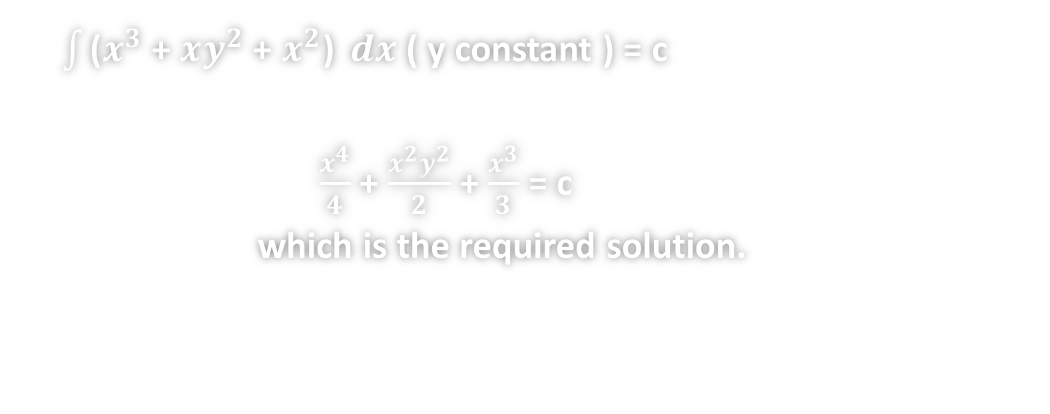
SOLUTION CONTINUES …
$\int{\text{(}x^{3}\text{ +} xy^{2}\text{ +} x^{2}\text{) }ⅆx}$ ( y constant ) = c
$\frac{x^{4}}{4}$ + $\frac{x^{2}y^{2}}{2}$ + $\frac{x^{3}}{3}$ = c
which is the required solution.

Slide 8
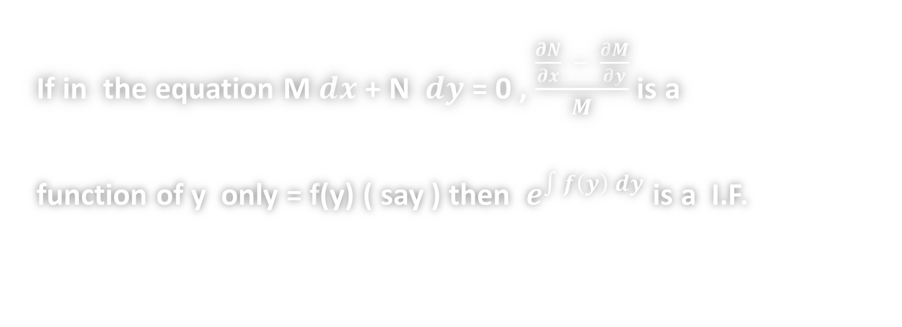
RULE 4
If in the equation M $ⅆx$ + N $ⅆy$ = 0 , $\frac{\frac{∂N}{∂x} − \frac{∂M}{∂y}}{M}$ is a
function of y only = f(y) ( say ) then $e^{\int{f\left(y\right) dy}}$ is a I.F.

Slide 9
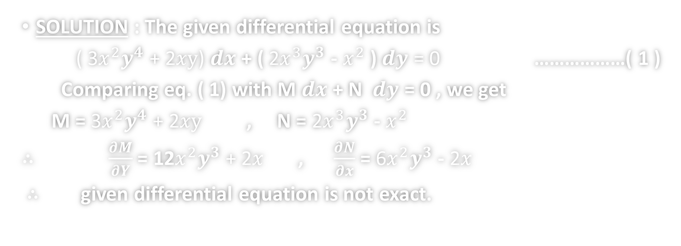

PROBLEM 2 : Solve
( 3$x^{2}y^{4}$ + 2$xy$) $ⅆx$ + ( 2$x^{3}y^{3}$ - $x^{2}$ ) $ⅆy$ = 0
SOLUTION : The given differential equation is
( 3$x^{2}y^{4}$ + 2$xy$) $ⅆx$ + ( 2$x^{3}y^{3}$ - $x^{2}$ ) $ⅆy$ = 0 ………………( 1 )
Comparing eq. ( 1) with M $ⅆx$ + N $ⅆy$ = 0 , we get
M = 3$x^{2}y^{4}$ + 2$xy$ , N = 2$x^{3}y^{3}$ - $x^{2}$
∴ $\frac{∂M}{∂Y}$ = 12$x^{2}y^{3}\text{ + 2}x$, $\frac{∂N}{∂x}$ = 6$x^{2}y^{3}$ - $\text{2}x$
∴ given differential equation is not exact.

Slide 10
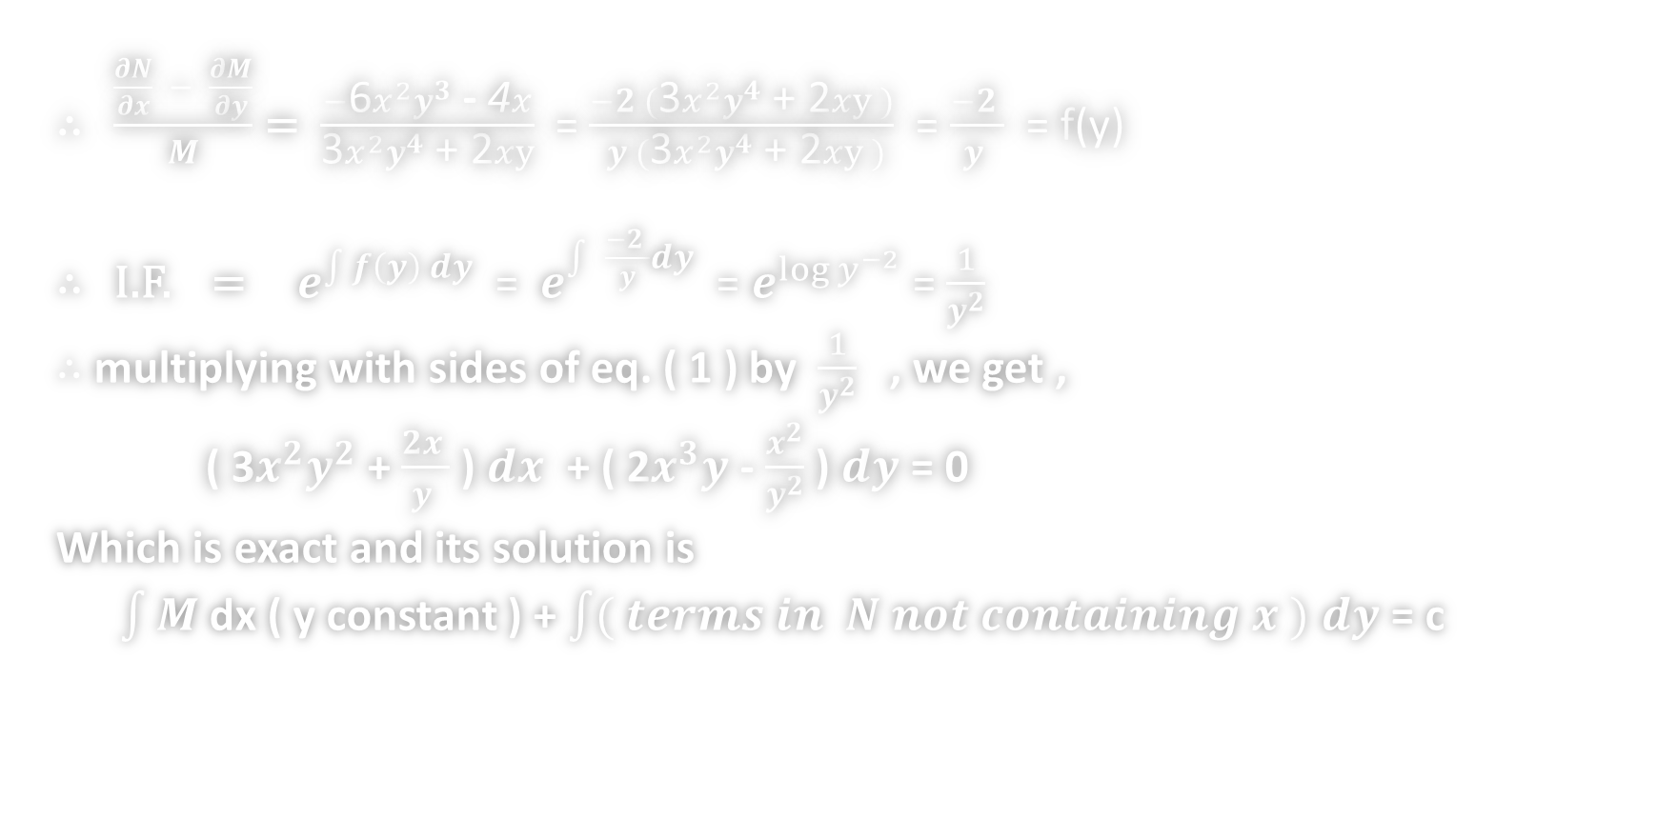
SOLUTION CONTINUES …
∴ $\frac{\frac{∂N}{∂x} − \frac{∂M}{∂y}}{M}$ = $\frac{−\text{6}x^{2}y^{3}\text{ −} \text{4}x}{\text{3}x^{2}y^{4}\text{ + 2}xy}$ = $\frac{−2 (\text{3}x^{2}y^{4}\text{ + 2}xy )}{ y (\text{3}x^{2}y^{4}\text{ + 2}xy )}$ = $\frac{−2 }{y }$ = f(y)
∴ I.F. = $e^{\int{f\left(y\right) dy}}$ = $e^{\int{ \frac{−2 }{y}dy}}$ = $e^{\log{y^{−2}}}$ = $\frac{1}{y^{2}}$
$∴$ multiplying with sides of eq. ( 1 ) by $\frac{1}{y^{2}}$ , we get ,
( 3$x^{2}y^{2}$ + $\frac{2x }{y }$ ) $ⅆx$ + ( 2$x^{3}y$ - $\frac{x^{2}}{y^{2}}$ ) $ⅆy$ = 0
Which is exact and its solution is
$\int{M}$ dx ( y constant ) + $\int{( terms in N not containing x )}$ $ⅆy$ = c

Slide 11
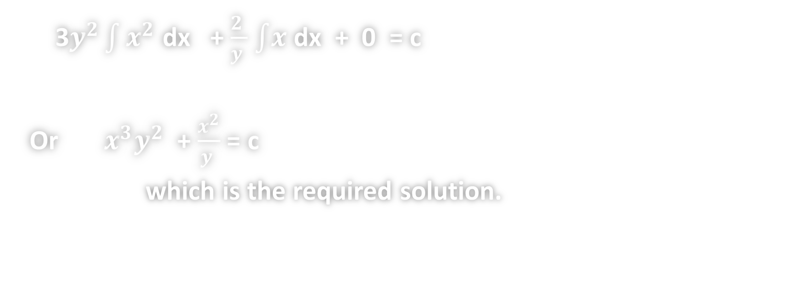
SOLUTION CONTINUES …
3$y^{2}\int{x^{2}}$ dx + $\frac{2 }{y }$ $\int{x}$ dx + 0 = c
Or $x^{3}y^{2}$ + $\frac{x^{2}}{y }$ = c
which is the required solution.

Slide 12
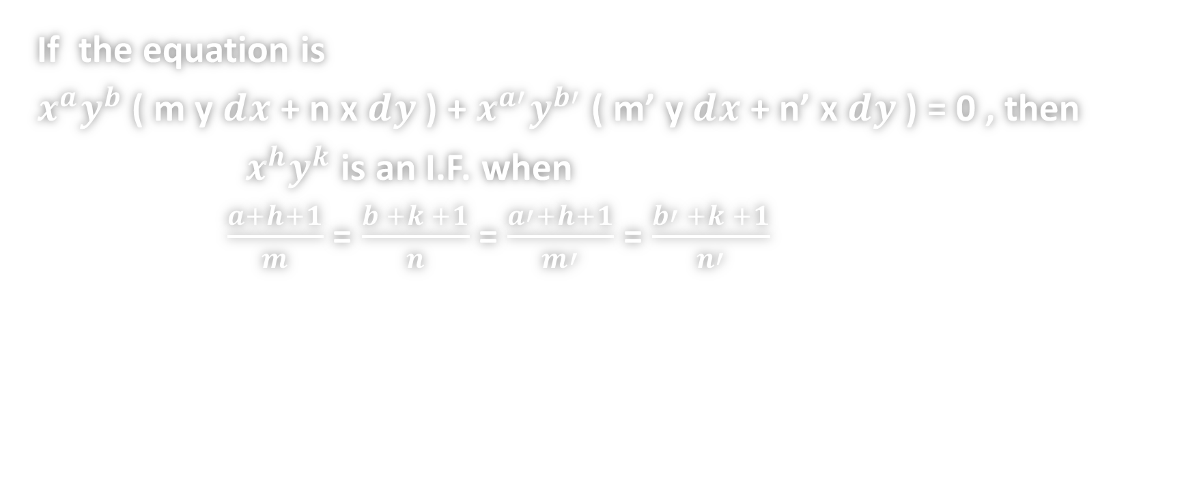
RULE 5
If the equation is
$x^{a}y^{b}$ ( m y $ⅆx$ + n x $ⅆy$ ) + $x^{a′}y^{b′}$ ( m’ y $ⅆx$ + n’ x $ⅆy$ ) = 0 , then
$x^{h}y^{k}$ is an I.F. when
$\frac{a+h+1}{m}$ = $\frac{b +k +1}{n}$ = $\frac{a′+h+1}{m′}$ = $\frac{b′ +k +1}{n′}$

Slide 13
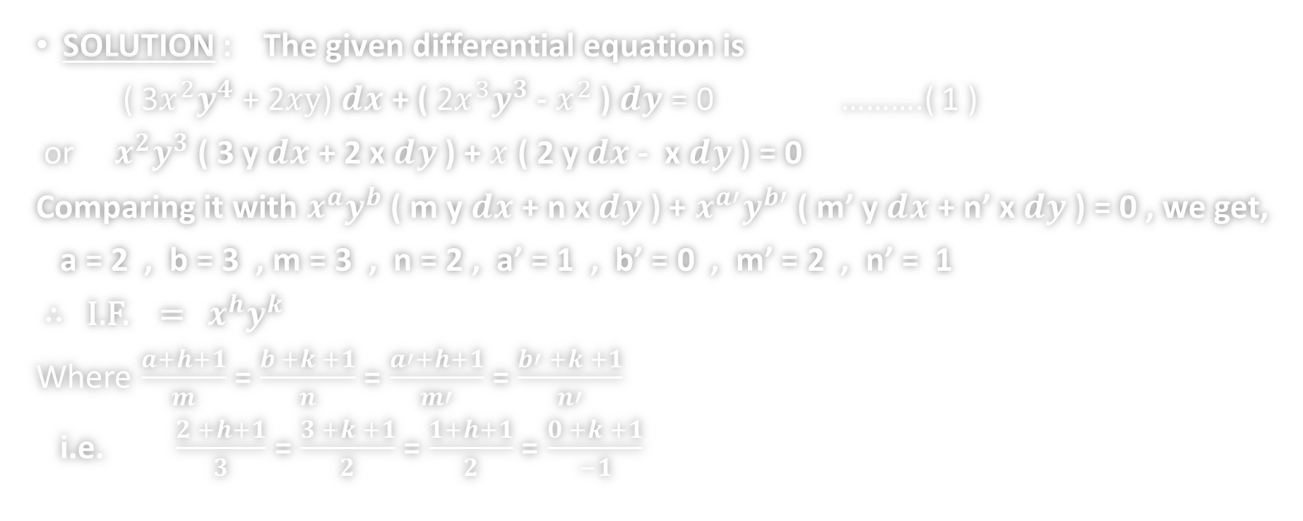
PROBLEM 2 : Solve
( 3$x^{2}y^{4}$ + 2$xy$) $ⅆx$ + ( 2$x^{3}y^{3}$ - $x^{2}$ ) $ⅆy$ = 0
SOLUTION : The given differential equation is
( 3$x^{2}y^{4}$ + 2$xy$) $ⅆx$ + ( 2$x^{3}y^{3}$ - $x^{2}$ ) $ⅆy$ = 0 ……….( 1 )
or $x^{2}y^{3}$ ( 3 y $ⅆx$ + 2 x $ⅆy$ ) + $x$ ( 2 y $ⅆx$ - x $ⅆy$ ) = 0
Comparing it with $x^{a}y^{b}$ ( m y $ⅆx$ + n x $ⅆy$ ) + $x^{a′}y^{b′}$ ( m’ y $ⅆx$ + n’ x $ⅆy$ ) = 0 , we get,
a = 2 , b = 3 , m = 3 , n = 2 , a’ = 1 , b’ = 0 , m’ = 2 , n’ = 1
∴ I.F. = $x^{h}y^{k}$
Where $\frac{a+h+1}{m}$ = $\frac{b +k +1}{n}$ = $\frac{a′+h+1}{m′}$ = $\frac{b′ +k +1}{n′}$
i.e. $\frac{2 +h+1}{3}$ = $\frac{3 +k +1}{2}$ = $\frac{1+h+1}{2}$ = $\frac{0 +k +1}{−1}$

Slide 14
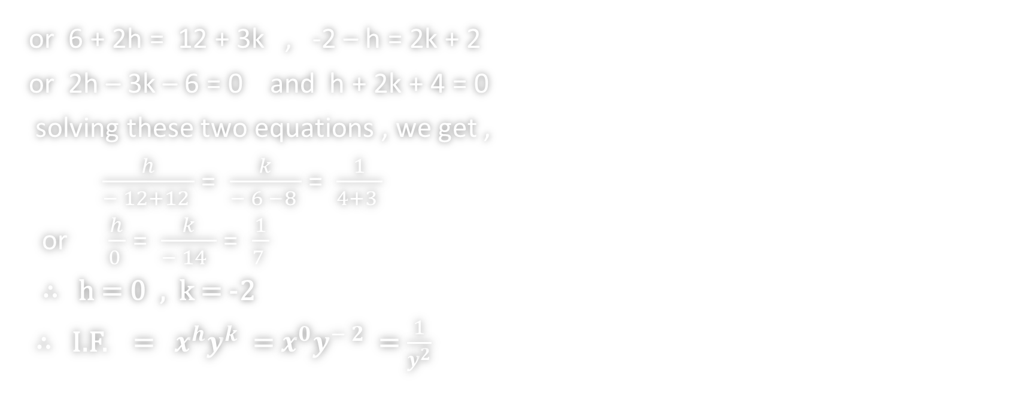
SOLUTION CONTINUES …
or 6 + 2h = 12 + 3k , -2 – h = 2k + 2
or 2h – 3k – 6 = 0 and h + 2k + 4 = 0
solving these two equations , we get ,
$\frac{h}{− 12+12 }$ = $\frac{k}{− 6 −8 }$ = $\frac{1}{4+3 }$
or $\frac{h}{0 }$ = $\frac{k}{− 14 }$ = $\frac{1}{7 }$
∴ h = 0 , k = -2
∴ I.F. = $x^{h}y^{k}$ = $x^{0}y^{− 2}$ = $\frac{1}{y^{2}}$

Slide 15
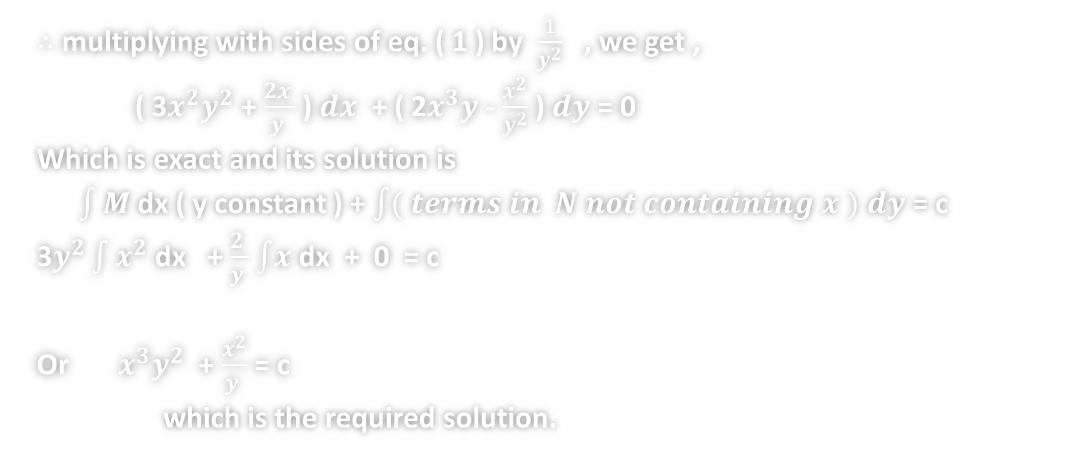
SOLUTION CONTINUES …
$∴$ multiplying with sides of eq. ( 1 ) by $\frac{1}{y^{2}}$ , we get ,
( 3$x^{2}y^{2}$ + $\frac{2x }{y }$ ) $ⅆx$ + ( 2$x^{3}y$ - $\frac{x^{2}}{y^{2}}$ ) $ⅆy$ = 0
Which is exact and its solution is
$\int{M}$ dx ( y constant ) + $\int{( terms in N not containing x )}$ $ⅆy$ = c
3$y^{2}\int{x^{2}}$ dx + $\frac{2 }{y }$ $\int{x}$ dx + 0 = c
Or $x^{3}y^{2}$ + $\frac{x^{2}}{y }$ = c
which is the required solution.

Slide 16
Thankyou

